Slide 1
Szuperkritikus, ultra-szuperkritikus erőmű

Slide 2
What is a Supercritical Power Plant?
written by: johnzactruba • edited by: Lamar Stonecypher • updated: 7/3/2010
Modern thermal power plants operate at very high pressures greater than the Critical pressure of steam. This article explains the concept of Supercritical power plants.
"Steam is no stronger now than it was a hundred years ago, but it is put to better use.“ - Ralph Waldo Emerson
To increase the efficiency of steam power plants the basic method is to improve the thermal efficiency by increasing the operating pressure. To understand what a Supercritical power plant is you have to understand the basics of steam generation.
What happens when you heat water at normal atmospheric pressure?
There are three stages.
As you go on heating the water, the temperature of water increases till it reaches 100 deg C. This is the Sensible Heat addition. Further heating does not increase the temperature; instead small bubbles of steam start to form. The temperature remains constant at 100 deg C till all the water becomes steam. The water absorbs the heat without temperature change for conversion to steam. At atmospheric pressure the Latent Heat of vapourisation is 2256 kJ/kg. Further heating called superheating will increase the temperature of the steam. How high one can go depends on the withstanding capacity of the vessel.

Slide 3
What happens when the water is at a higher pressure, say, at 100 bar?
Then the boiling takes place at 311 deg C and the latent heat of vaporisation is 1318 kJ/kg. If the water pressure is 200 bar then the boiling takes place at 366 deg C and the latent heat of vaporisation is 584 kJ/kg. As the pressure increases the boiling temperature increases and the latent heat of vaporisation decreases. A further increase in pressure and temperature leads us to a point at which the latent heat of vaporisation is zero, or there is no boiling. Water directly becomes steam. This is the Critical Pressure and the Critical Temperature. For steam this occurs at 374 deg C and 220.6 bar.
Conventional steam power plants operate at a steam pressures in the range of 170 bar. These are Subcritical power plants. The new generation of power plants operate at pressures higher than the critical pressure. These are Supercritical power plants. The operating pressures are in the range of 230 to 265 bar. The efficiency of the Rankine cycle depends on the pressure at which it operates. Higher pressure and temperature increase the efficiency of the thermal cycle and power plant. This is the reason for operating at higher steam pressures.
Ultra Supercritical Power Plants
In the quest for higher efficiency the trend is to go for still higher operating pressures. The next generation of power plants will operate with steam Pressures in the range of 300 bar. These are the Ultra Super Critical Power plants. Ultra Supercritical Units operate at temperatures of 615 to 630 deg C.

Slide 4
Efficiency gain due to Supercritical parameters
•Supercritical units have higher plant efficiency than that of
subcritical units because of higher steam parameters.
• The Gross plant efficiency is around 40‐41% for supercritical units
with steam parameters of 24.7MPa/565/593 ⁰C, which is about
2%‐3% higher than that (38%) of sub‐critical unit with steam
parameters of 16.7MPa/537/537 ⁰C
•The Gross plant efficiency is around 41‐42% for ultra‐supercritical
units with steam parameters of 28MPa/593 ⁰C /593 ⁰C,which is
about 3‐4% higher than that of the above supercritical units.
•The advanced ultra supercritical units have reached an overall
plant efficiency of 47% to 49% in the world.

Slide 5
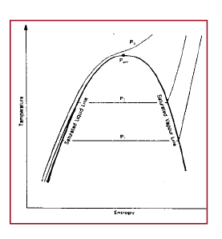
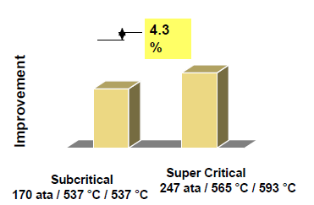

Slide 7
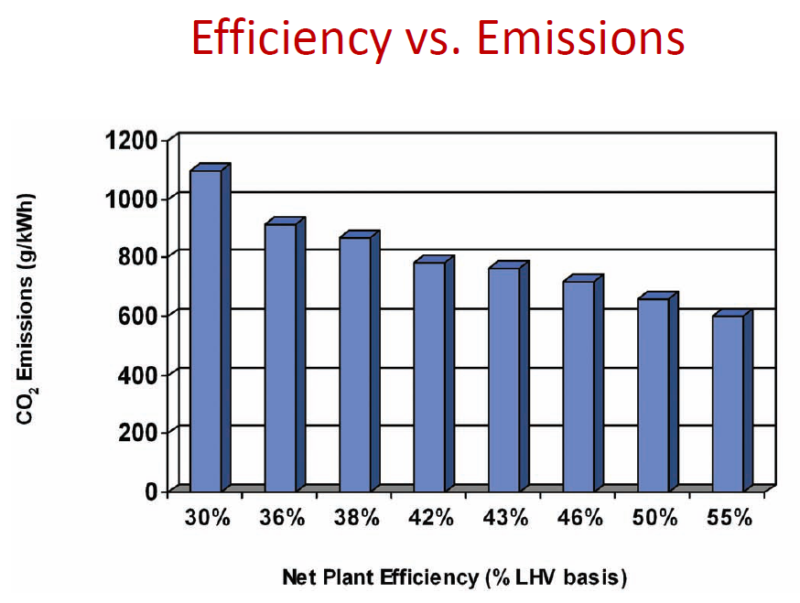

Slide 11
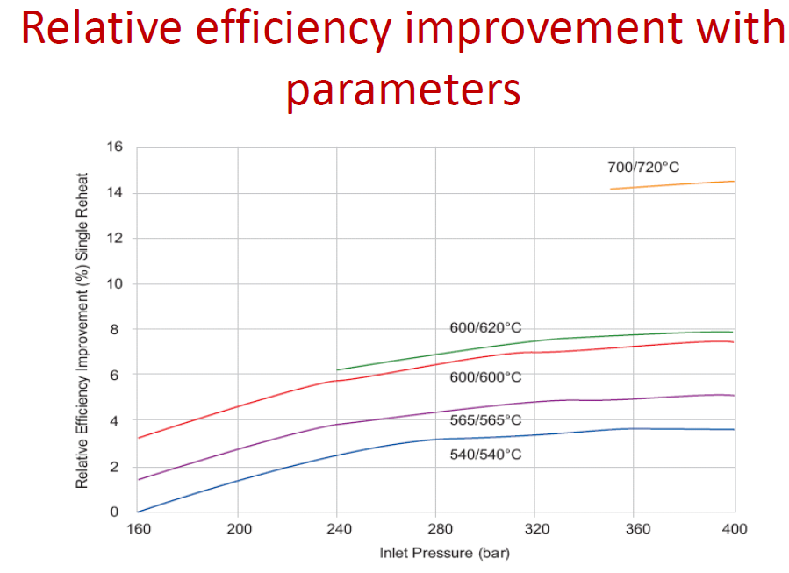

Slide 12
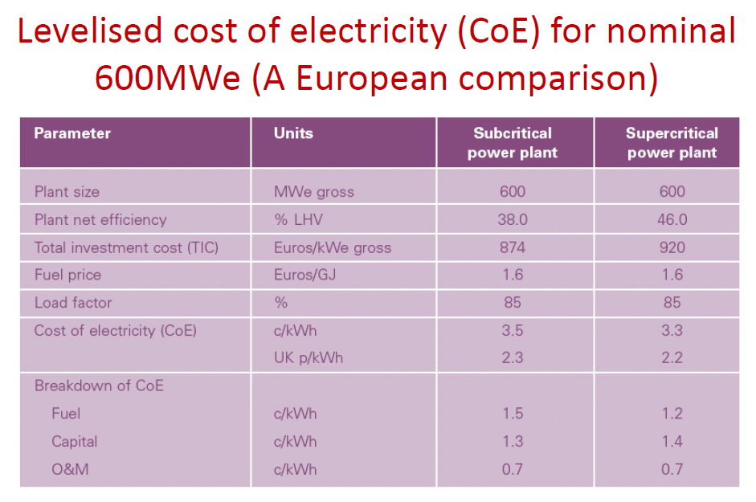

Slide 13
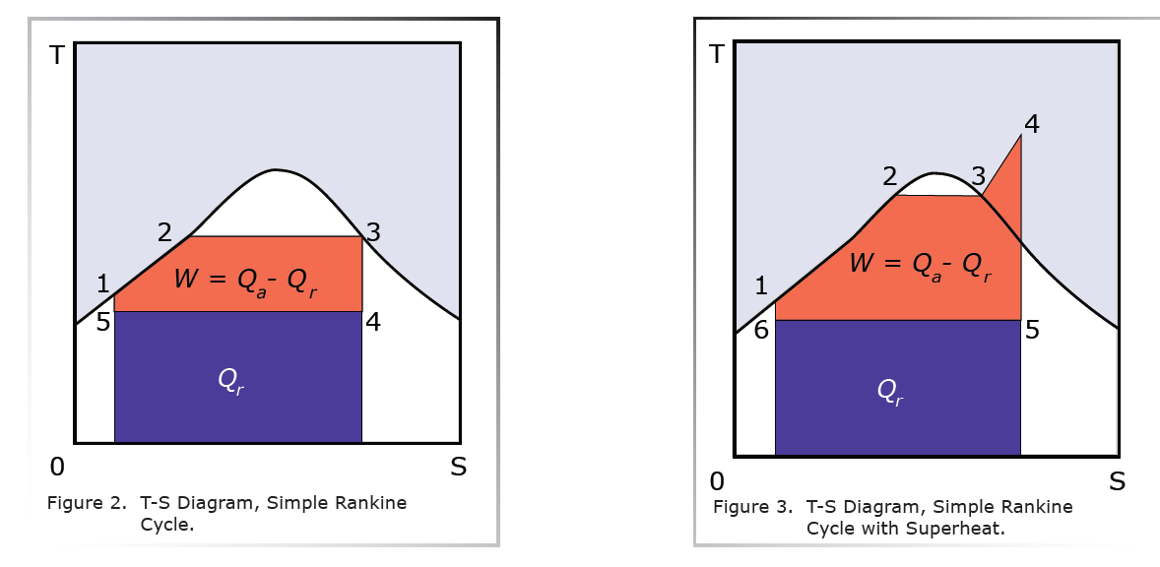

Slide 14
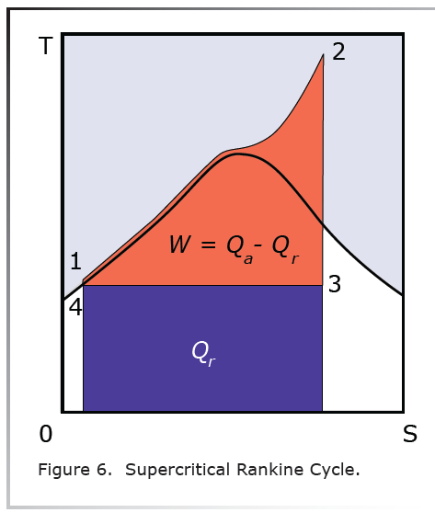
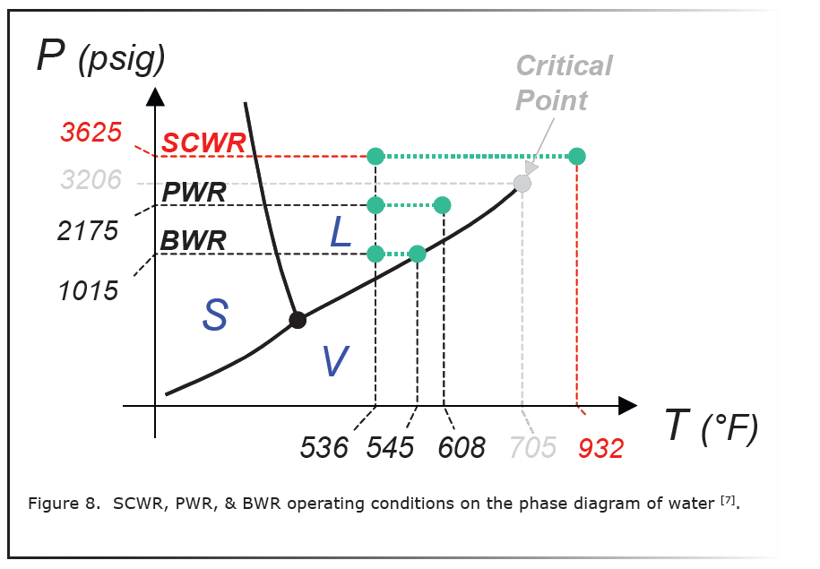

Slide 15
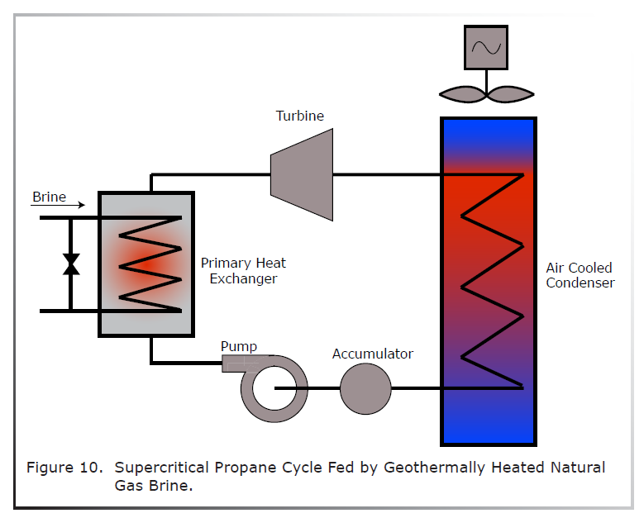
In many cases, the source for Natural Gas production is a geothermally heated brine. In these cases, the brine temperatures range from 240 oF (390 K) up to 360 oF (455 K) depending linearly upon well depth [8]. In this temperature range, the brine passes through a heat exchanger to feed a supercritical Rankine cycle for Propane, which has a critical temperature of 206 oF (370 K) and a critical pressure of 616 psia. Theoretically, the brine may be able to run the cycle directly but there are too many contaminants and compositional variations for this to be feasible. If a power cycle like this were employed, the sites producing Natural Gas could potentially generate power for Grid use or, at a minimum, generate the majority of the plant’s electrical requirements. In the United States, there are several areas along the Texas and the Louisiana Gulf Coast where this type of power cycle is feasible [8].

